Slide 1
Learner Journey Introduction

Slide 2
Essentially, the Learner Journey at EHS is all about how each individual engages with options, choices, opportunities and experiences that are available between entry and exit points (start and finish of school).
The key aim for our school is to ensure that each individual student leaves school with a positive destination that is fully appropriate to their personal skills, qualities, abilities and interests.
This destination should be the preferred option for the individual who should also be equipped with sustainable, transferable employability skills such as numeracy, ICT skills, teamwork, research skills, creativity and effective communication.
Destinations include college, university, employment, volunteering, Modern Apprenticeships, training and running your own business. These could also be considered as stepping stones towards the destination.

Slide 3
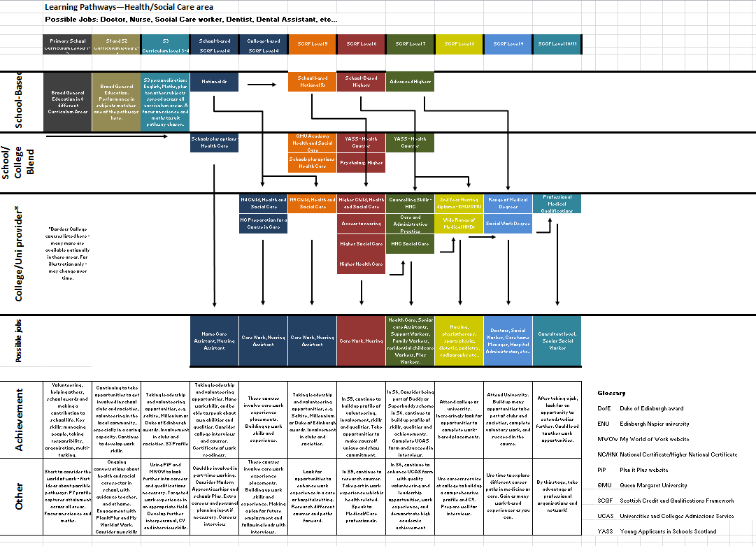

Slide 4
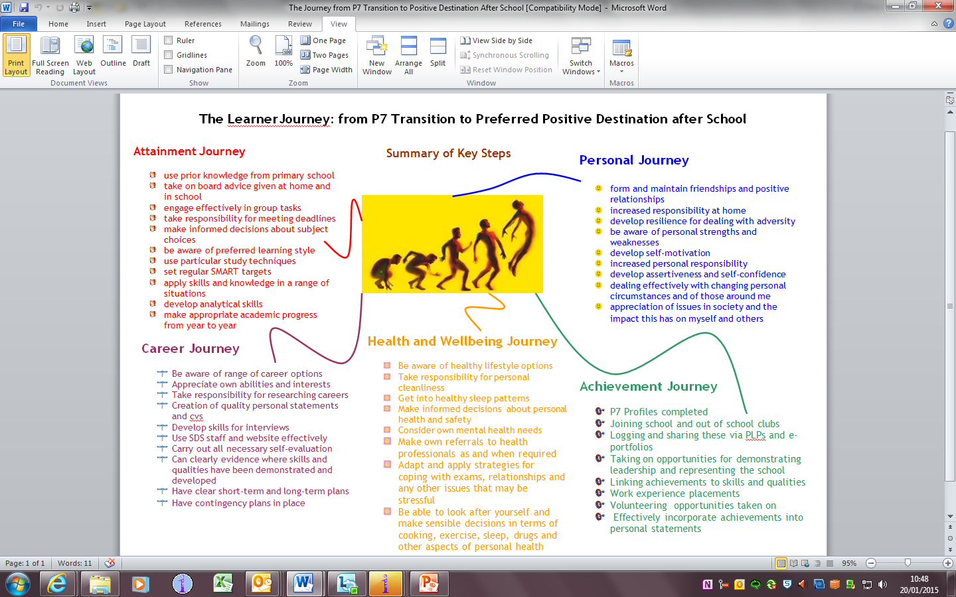

Slide 5
Achievement
Attainment
Careers
HWB
Personal

Slide 6
Learner Journey
HWB
Subjects

