Slide 1
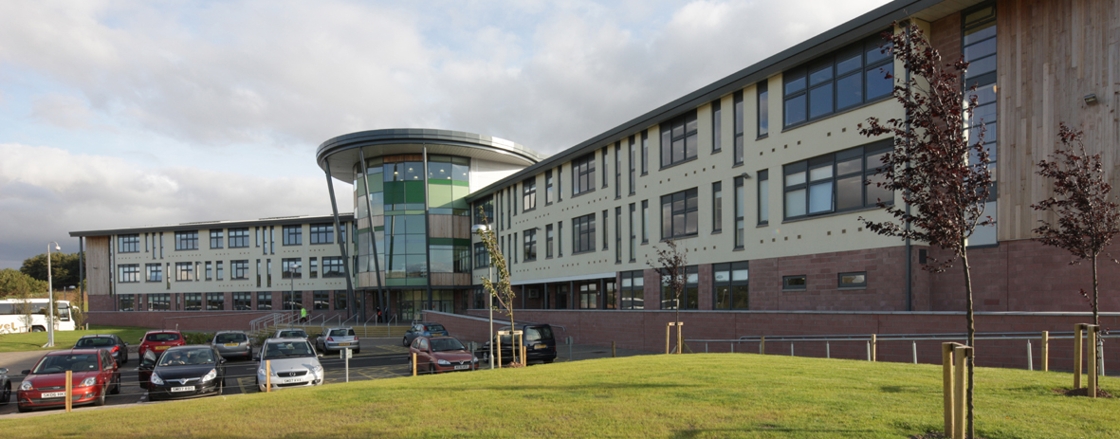
Leadership Roles

Slide 2
Roles available
Head team- 4
House captains (Two for each house)- 10
Sports captains- (Two for each house)- 10
Prefects- approximately 6 for each house
Literacy Ambassadors- Advanced higher English class
Learning Ambassadors – Mrs Weston in charge of them
Committee leaders- 1 for each committee

Slide 3
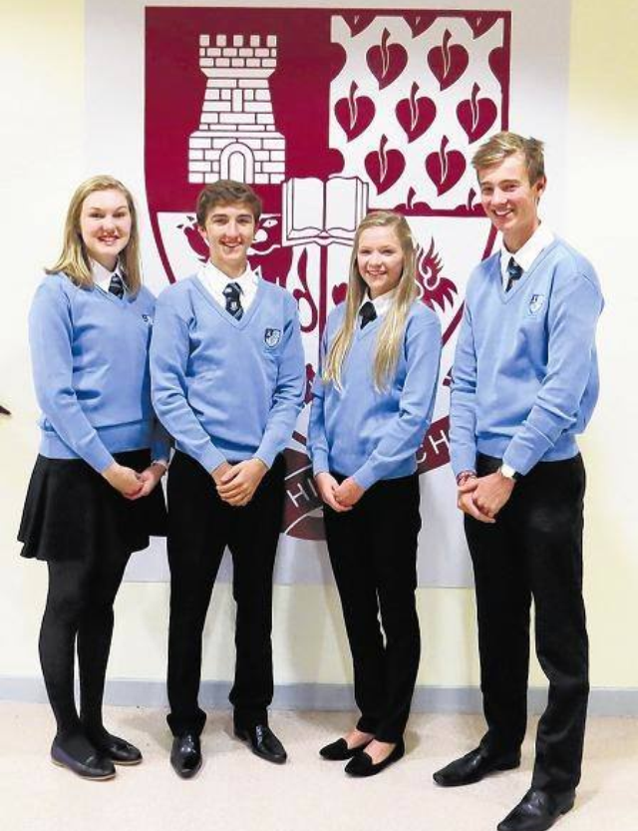
Head Team
What the role entails?
Representing the school at events within the school but also the community e.g. Remembrance Sunday
Make speeches: Dux assembly, Burns Supper, Leaving evening, Readings at church services etc..
Management of committees
Tours of the school
Attending events such as school shows and concerts
Comparing the 1st act of the Christmas concert
Going to conference's with other head teams
Attending other schools dances
Being role models within and outwith the school

Slide 4
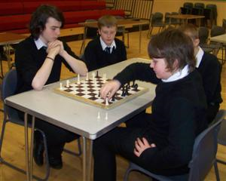
House Captains
Run house events
Speak at house assemblies
Be a responsible, motivational role model for their house
Work to improve house points system
Keep notice boards updated
Create rota when house is on prefect duty
Monitior prefects and make sure that they are carrying out their duties- remind them to check in

Slide 5
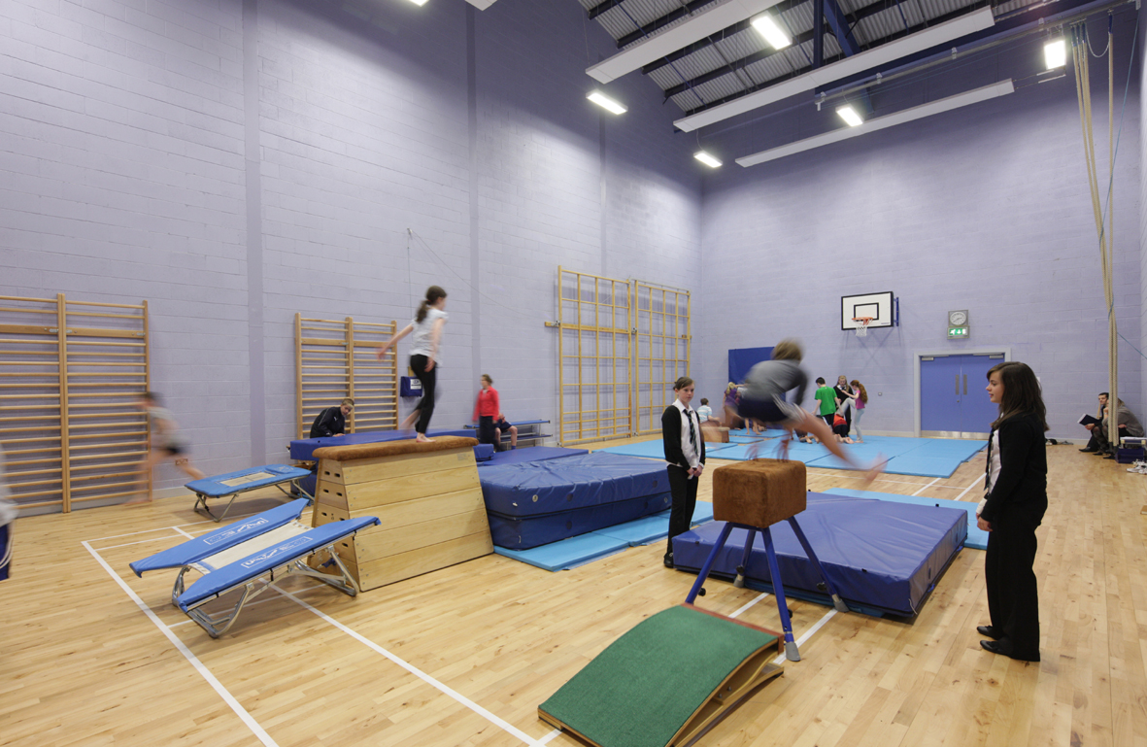
Sports captains
Create inter-house sporting events
Work to improve the house system
Be a responsible, motivational role model for their house

Slide 6
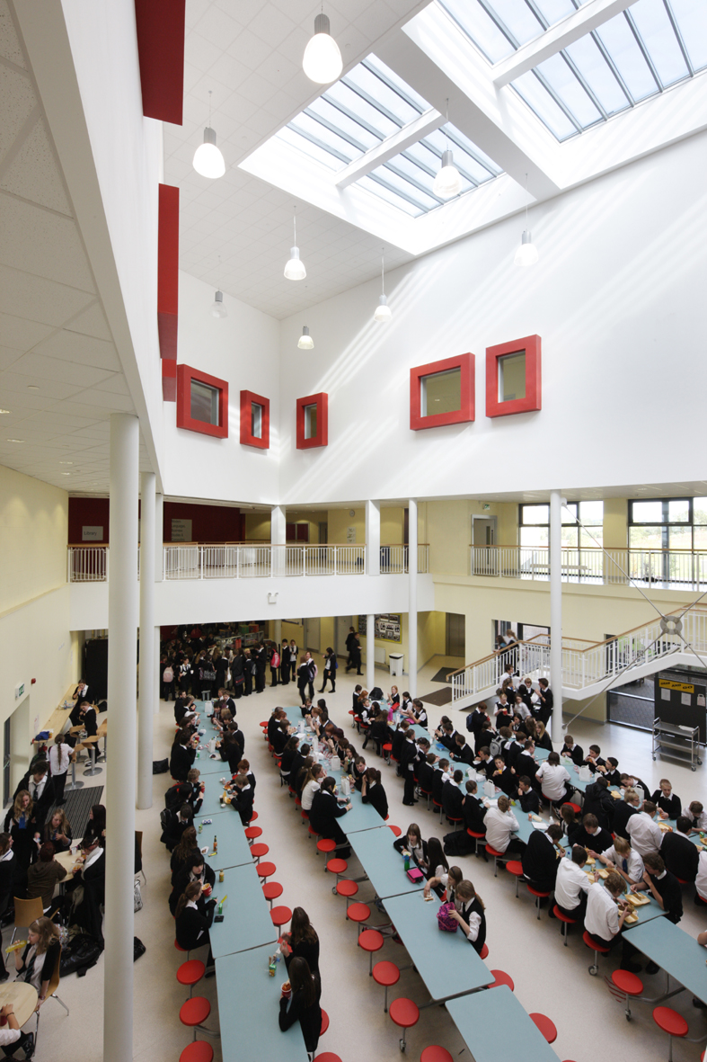
Prefects
Manage lunch queues
Monitor corridor's during lunch time and break time (2 per floor)
Help put out grab and go’s
Act as a role model to younger students
Challenge people about dropping litter
Pass on those who are misbehaving to go on report
Enforce the school rules
Provide availabilty for duties to house captains
Play a role in assemblies
Set a good example
Check in for patrolling at 1.45pm with Mr Burrell

Slide 7
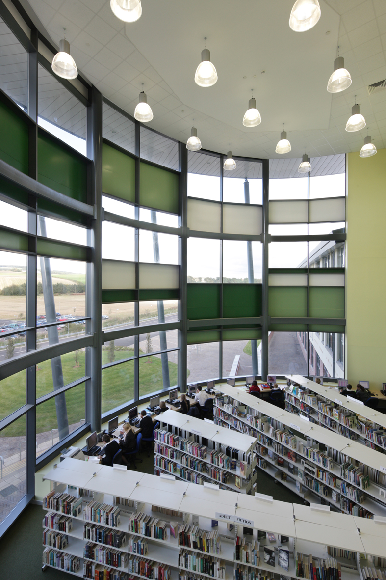
Literacy ambassadors
Encourage reading and other literacy based activities around the school
Helping to set up the literacy café
Help with classes in Learning support for first year children who struggle with basic literacy skills on a weekly basis

Slide 8
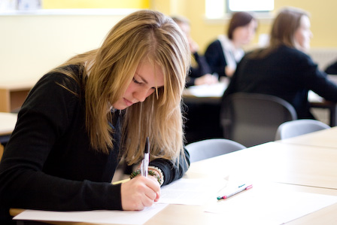
Learning Ambassadors
To teach people about study skills so that they can revise and work efficiently
Involves creating and delivering lessons for 4th years on study skills and how to make the most out of your studying
Also have a role in the setting up of the literacy café

Slide 9
The application process

Slide 10
Head team
Application form based around your S5 personal statement including reasons why you would be suitable for the role eg. qualities and previous leadership experience. This is to be handed into Mrs McDonald or the office
The applications are then analysed and the applicants’ names are given out on a ballot paper to the whole of your year for voting to take place- on who they believe are the best candidate (Vote for 1 boy and 1 girl)
The top 5 boys and top 5 girls are then asked to prepare a short presentation about why you are suitable for the role to be presented to the entire year group and the panel. The panel generally includes: senior management, junior pupils and at least one member of the previous head team. Please note that such presentations do not involve power points.

Slide 11
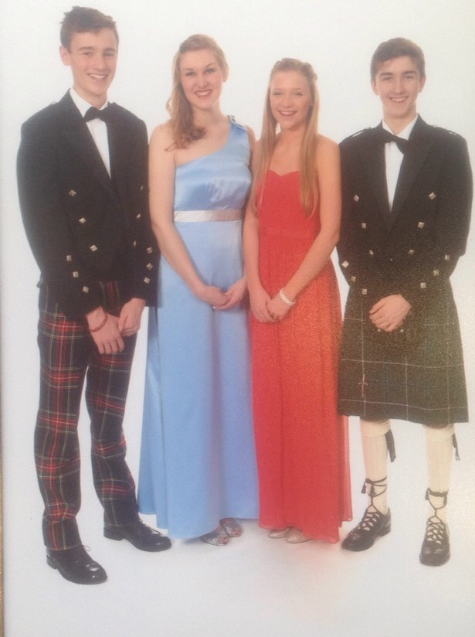
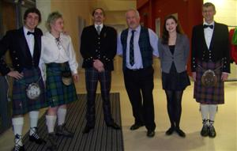
Following the presentation, the same panel will interview you and assess your suitability for the role
Following the process, all candidates will be informed of their success or not.

Slide 12
Some words of Advice
These roles are extremely enjoyable but also extremely time consuming
Be aware that study periods, afterschool and even whole school days can be taken up by the duties and responsibilities of this role
There is a lot of responsibility on you and you must be prepared to make decisions and accept the consequences. Not everyone will be pleased with what you do all of the time
Communication between the head team members is vital since the work load is so heavy that everyone must get on well and do their fair share of work
Despite this, it is very rewarding and great fun as demonstrated at the Christmas dance!

Slide 13
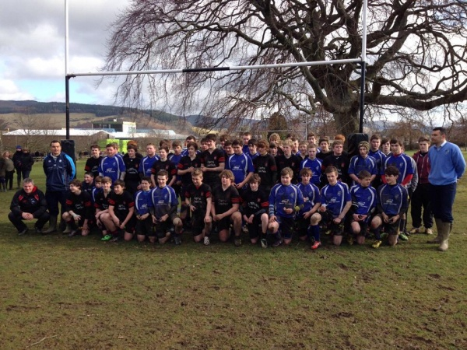
House and sports captains
Apply initially in the same way as head team with a letter of application. Please note, that you can apply for more than one role and state clearly on your application what you are applying.
All candidates who specified that they wish to be a house captain (unless already elected as a member of the head team) will have their name put on a ballot paper in which the year group will vote on.
Again, it tends to be one boy and one girl who are elected.

Slide 14
Prefects
They apply again through a letter of application.

Slide 15
Some words of advice for 6th year
From the very start of 6th year you must seriously be considering what your next steps are. The year flies by and before you know it, it will be your leavers’ evening.
Enjoy the roles and responsibilities that come with your blue jumper.
Respect the new places you have been rewarded with (e.g. common room, art room).
Yes, it may seem like you have los of study periods to waste playing Fifa in the common room or watching movies but in all honesty, use them well or when it comes to prelims, coursework deadlines you will regret spending all those hours trying to improve your ultimate team.

Slide 16
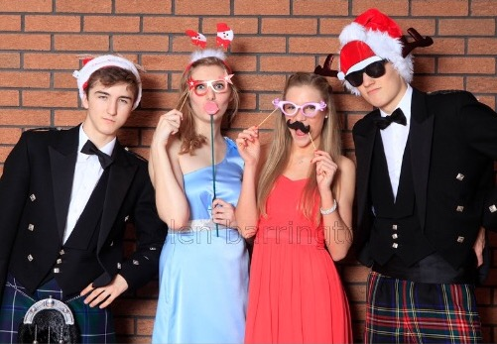
Any Questions?

