Slide 2
IN THIS ACTIVITY YOU’LL:
Understand the importance of a good first impression
Demonstrate how to make a good first impression
Know some positive ways to stand out from the crowd.

Slide 3
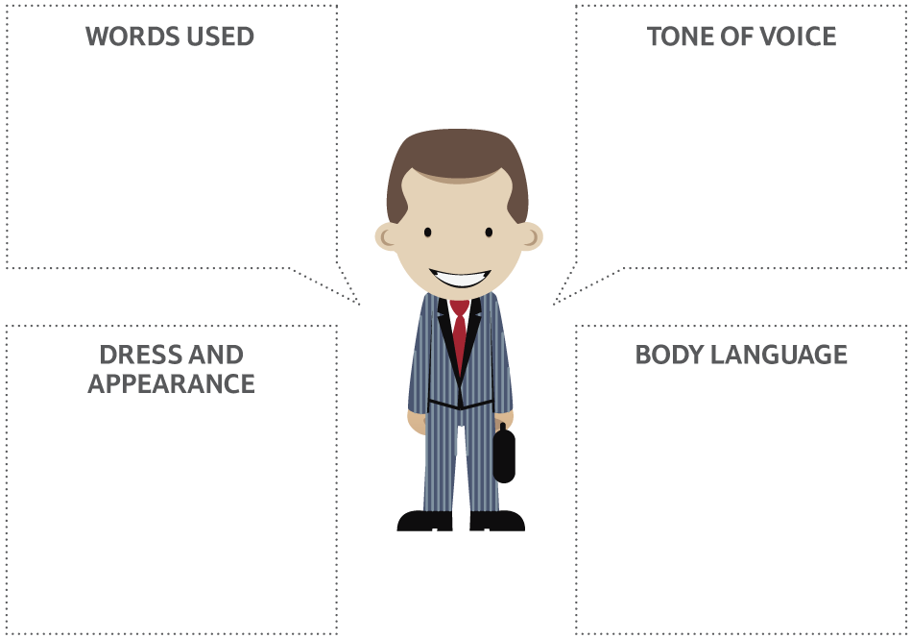
IMPRESS WITH YOUR:

Slide 4
HOW WOULD YOU MAKE A GOOD IMPRESSION WHEN YOU:
Walk into an interview room and greet the interviewer?
Meet the manager in a shop or other business and ask if there are any job opportunities?
Meet a recruiter at an open day or careers fair, and ask about the company and the jobs on offer?

Slide 5
MAKING A GOOD IMPRESSION
Be prepared
Be yourself
Be well groomed
Be friendly and confident
Be aware of your nervous habits
Be polite and attentive.

Slide 6
CASE STUDY
Being a Store Manager the skill of presenting yourself in the correct way is used everyday in all interactions with Customers and Colleagues.
A great example is when we engage with the local community. The advantage of making a great impression not only allows you to build rapport and communicate more effectively but paints a great impression of Tesco and our brand. Selecting the appreciate dress is important, whether that be business dress (in a suit) or more taking a more casual approach to put people at ease. Good posture and body language all help create a great first impression and give you confidence. Engaging, listening and responding in the right tone and volume is also really important.
I am a Store Manager in Gerrards Cross in Buckinghamshire. I think I have the best job in Tesco. Not only is every day different and challenging, but I get to lead and coach a great team of people with one goal - to make every customer have a great experience every time.
Please include a photo of yourself
James Lingard, Store Manager, Tesco Young People’s Panel member. Joined Tesco in 2005.

Slide 7
WHAT ARE YOU GOING TO DO DIFFERENTLY?

