Slide 1
Notes:
We are here to talk to you today about the four Academies that have been set up for all schools in south east Scotland.

Slide 2
Why have the academies been set up in these industries ?
How will you benefit from joining one of the academies?
Notes:
You are probably sitting there wondering why these academies have been set up and why should you join one of the academies – what is in it for you.
To answer the first question - all the academies have been set up to help you get qualifications, skills and experiences that will help you get to college or university or directly into a job. The academies have been set up in the industries that Scottish Government have recognised as being key areas of economic growth – so that means that there will be jobs in these industries in the future.
As we go through the presentation you will get the answers as to how you will benefit from being an academy student.

Slide 3
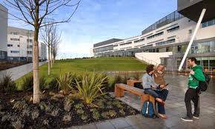
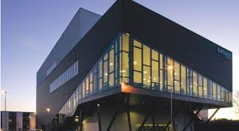
Join one of the Academies while you are in S5 or S6 and also be a student ….
…. at Queen Margaret University
& at Edinburgh, Borders or West Lothian College
Notes:
So here is the first benefit of being an academy student. Join the academy while you are school and become an associate student at uni and college.
So what does that mean? The way the academies work is that you join one of the academies while you are still at school. You still attend your classes at school but you go to either the college or uni for your academy classes. In first year, the majority of the academy classes take place on a Friday afternoon.
When you join one of the academies, you become an associate student of both QMU and Edinburgh College. That means you get an enrolment card which gives you entry to all the facilities on the uni and college campus – for example the library, the canteen and the sports centres.
By attending classes at college or uni and using their facilities, this means that it will be much easier for you when you leave school as you will be very familiar with the college and university set up.

Slide 4
Join one of the Academies…. ….and develop academic skills
Independent study research skills referencing skills
essay writing coursework report writing
Notes:
Another way that the academies make it easier for you to move from school to college or uni is by helping you to develop academic skills. These are the skills that our current university students say they were lacking when they came to uni from school. Another benefit of joining the academies is that you will be able to use these skills while you are at school to help you while studying for your school qualifications.

Slide 5
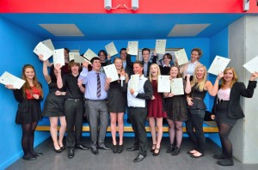
Join one of the academies … ….and gain relevant qualifications
National Progression Award Skills for Work Higher National Certificate
Use your qualifications - to help you with your application to College or University
or to help you get employment
Notes:
Whatever academy you join, you will gain relevant qualifications and that has got to be a benefit. The picture in the slide is of the HT students in June last year showing the certificates that they achieved when they completed their first year of their academy.
You will be able to use your qualifications to help you get into college or uni, or to help you get a job when you leave school.

Slide 6
Join one of the academies …. ….and get work experience
Notes:
Whatever academy you join, you will get work experience. This picture shows the students in the creative industries academy when they were on a visit to the Forth One studios.

Slide 7
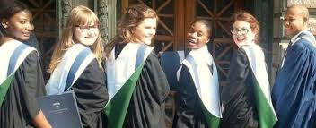
Join one of the Academies and you could get advanced entry to year 2 … … of an HND or … a Degree at Queen Margaret University
Notes:
This is a major benefit of joining the academies. By the end of year 2 of the academy, you will have qualifications which will allow you to go directly into year 2 of an HND or degree programme.
This means that you will get your qualification one year sooner than anyone starting year1. You will start earning one year earlier and will have one year less living costs to pay for – and that just might please your parents and guardians.

Slide 8
Academy student
Improve confidence
Meet students from other schools
Time management skills
Study skills
Become more independent
More likely to get a place at College or University
Notes:
So this is the final slide telling you why you should think about joining one of the academies. You will have improved confidence, better time management and study skills, you will be more independent, more likely to get a place at college or uni and your circle of friends will be larger as you will get to meet lots of other students from other schools.

Slide 9
South East Scotland Academies Partnership
Creative Industries Academy
Hospitality and Tourism Academy
Health and Social Care Academy
Food Science & Nutrition Academy

Slide 10
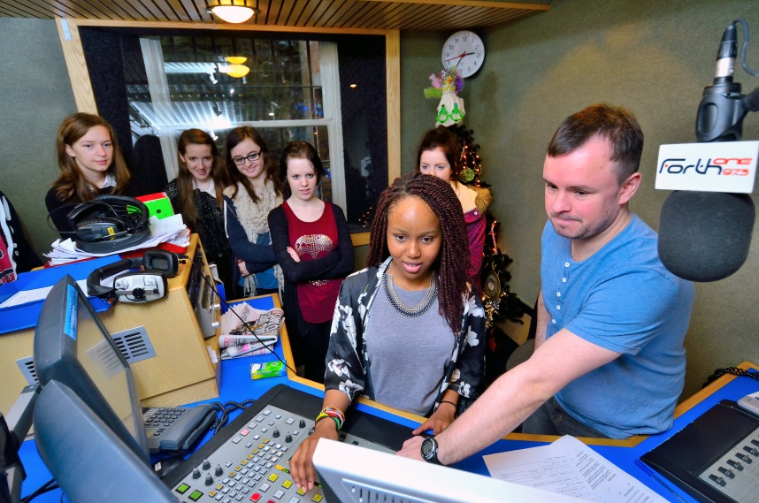
Creative Industries Academy
Media & Communication

Slide 11
HNC Creative Industries (Media & Communication)
Subjects studied include:
Video Production
Writing for the Media
Photography
Narrative in Fiction & Film
Completion of the HNC can lead to 2nd year of the following courses:
HND Creative Industries (Edinburgh College)
BA (Hons) Film & Media (Queen Margaret University)
BA (Hons) Media (Queen Margaret University)
BA (Hons) Public Relations & Media (Queen Margaret University)
Notes:
Media & Communication
Minimum Entry Criteria
3 qualifications (grade C or above) at SCQF level 5 including English for Year 1 in S5 and 2 Highers or equivalent at SCQF level 6 (grade C or above) including English for Year 2 in S6
Teaching (2014/15)
Year 1 teaching – Fri pm (Milton Road or Sighthill and QM)
Year 2 teaching – Tues and Thurs pm (Milton Road and QM)
Fast-track/Direct Entry option Fri, Tues and Thursday
Competitive so interviews – commitment to course, enthusiasm and motivation as important as academic qualifications.

Slide 12
Possible Job Roles – Creative Industries Sector
Advertising Executive Copywriter Art Director Actor Location Manager Media Planner Public Relations Officer Animator Programmer Production Manager Camera Operator Journalist Graphic Designer Choreographer Editor Screenwriter Fashion Designer Creative Director Games Designer Animation Director
Camera Operator Lighting Director Production Manager Film Director Writer Costume Designer/Maker Photographer Stage Manager Web Content Manager Radio/TV Presenter

Slide 13
Hospitality and Tourism Academy
Subjects studied include:
Supervision
Management
Finance and Control Systems
Food Production Processes
Food & Beverage Service
Practical & theory

Slide 14
Hospitality and Tourism Academy
Completion of the HNC will lead the following courses:
QMU – Level 2 International Hospitality and Tourism Management degree
Edinburgh College – Year 2 of HND Hospitality Management
Employment / Modern Apprenticeship

Slide 15
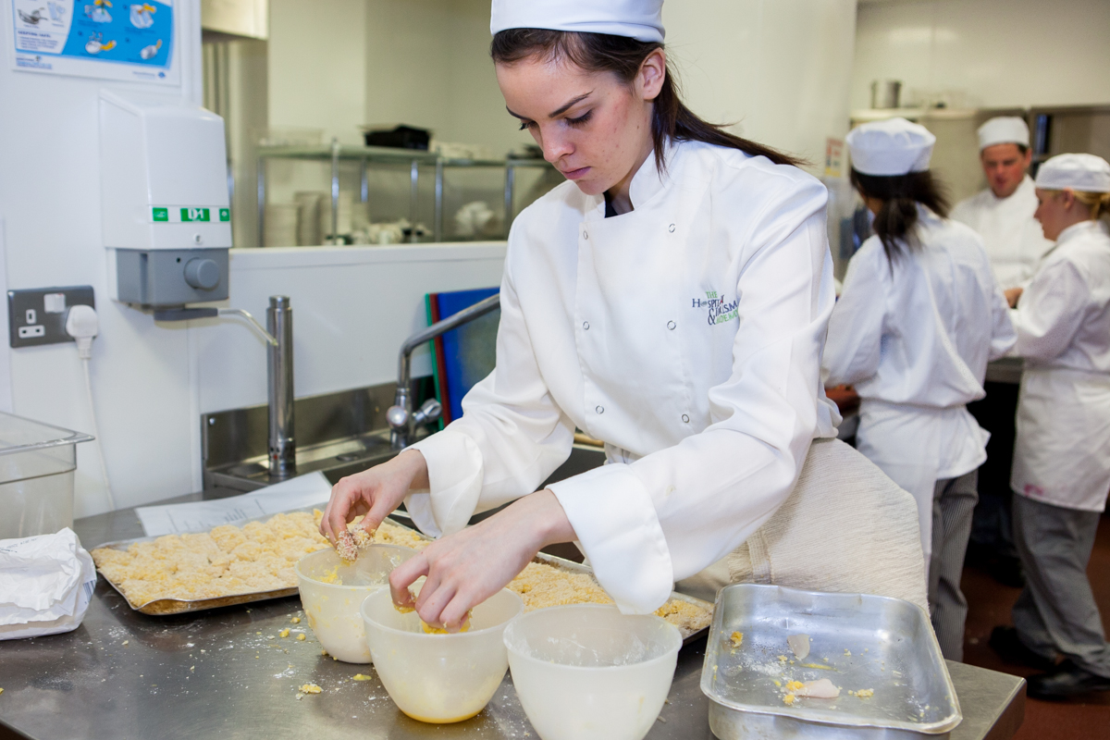
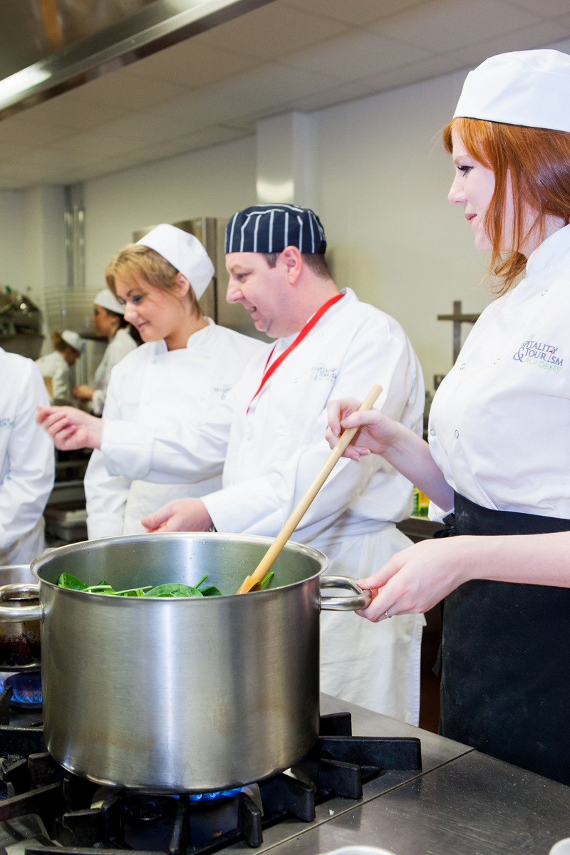
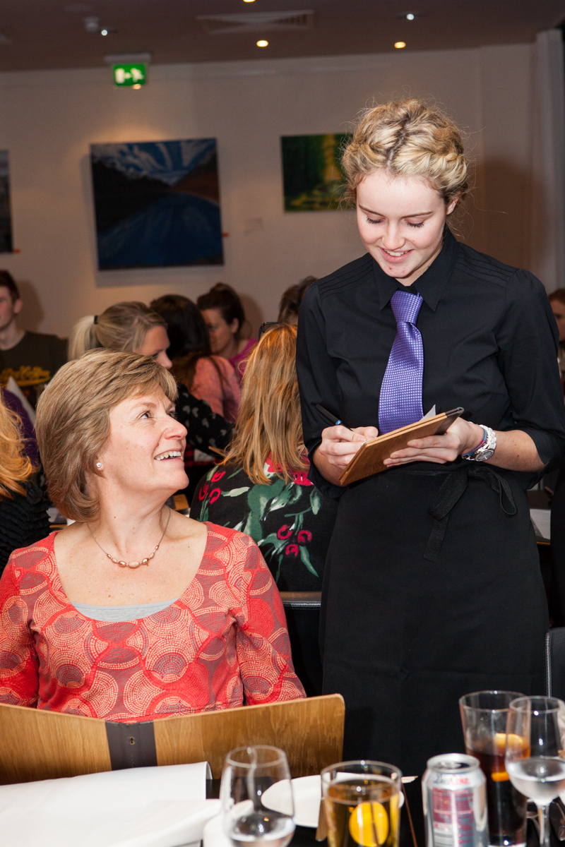

Slide 16
Possible job roles in Hospitality and Tourism industry
Reception Duty Manager Concierge Waiting Staff Restaurant Manager Hotels Head Chef Bar Staff Bar Manager Supervisors Conference and Events Coordinator Sales and Marketing Executive Housekeeper Human Resources Maintenance Operations Manager Sous Chef Conference and Events Manager Executive Chef Conference and Banqueting Staff and Managers Contract Catering Airport Executive Lounges (Product) Development Chef Coffee Shops Bakeries Sommelier Chef Manager Hospitality Manager Chef de Partie Housekeeping Pub Manager Facilities and Operations Manager Room Occupancy Manager Payroll Staff Finance Manager Procurement
Notes:
By the end of S5, you will have completed 4 HNC Hospitality modules in cookery processes, food service and supervision and the SfW National 5 in Hospitality.
Successful completion of S5 allows for progression to SVQ2 Professional Cookery at Edinburgh College or with 2 Highers, into Year 2 to complete your HNC Hospitality.
Progression routes include direct entry in Level 2 of International Hospitality and Tourism Management at Queen Margaret University with HNC Hospitality or into Year 2 of the HND Hospitality Management at Edinburgh College.
In Year 1 of the HT Academy, there are weekly classes at college or QMU; some of which are taught in the evenings and Friday afternoons.
In Year 2, the HT Academy is chosen as 1 column choice and the school allocate a Tuesday afternoon + 3 hours study periods within the column. In addition, the evening and Friday afternoon are allocated for the whole year.

Slide 17
Health and Social Care Academy
Qualifications studied include:
N5 Care qualification
Skills for Work Higher in Health & Social Care

Slide 18
Health and Social Care Academy

Slide 19
Possible job roles
Audiology Mental Health Worker Pharmacist Occupational Therapist Trainer Support Worker Dental Nurse Research Auxiliary Nurse Porter Support Staff IT & Research Health Sciences Midwife Therapist Auxiliary Nurse Health information Physiotherapists Nurse Medical secretary Carer Health Care Assistant Counsellor Health Promotion Ambulance driver Administrative support Health Visitor Music Therapist Osteopath Paramedic Podiatrist Radiographer
Destinations include; modern apprenticeship, employment and further or higher education

Slide 20
What do you need to do next to be involved?
Fill out an application form for the Academy that most interests you
Make sure that your parent/carer signs the form and then return it to your school
Not all applicants will be interviewed
Pupil interviews will take place in either your school or at either Edinburgh, Borders, West Lothian College or QMU from February to May 2015
The interview process will not only look at your ability to learn but also your enthusiasm
If you would like to learn more about any of the academies or the selection process, please arrange a meeting with your Guidance Teacher

Slide 21
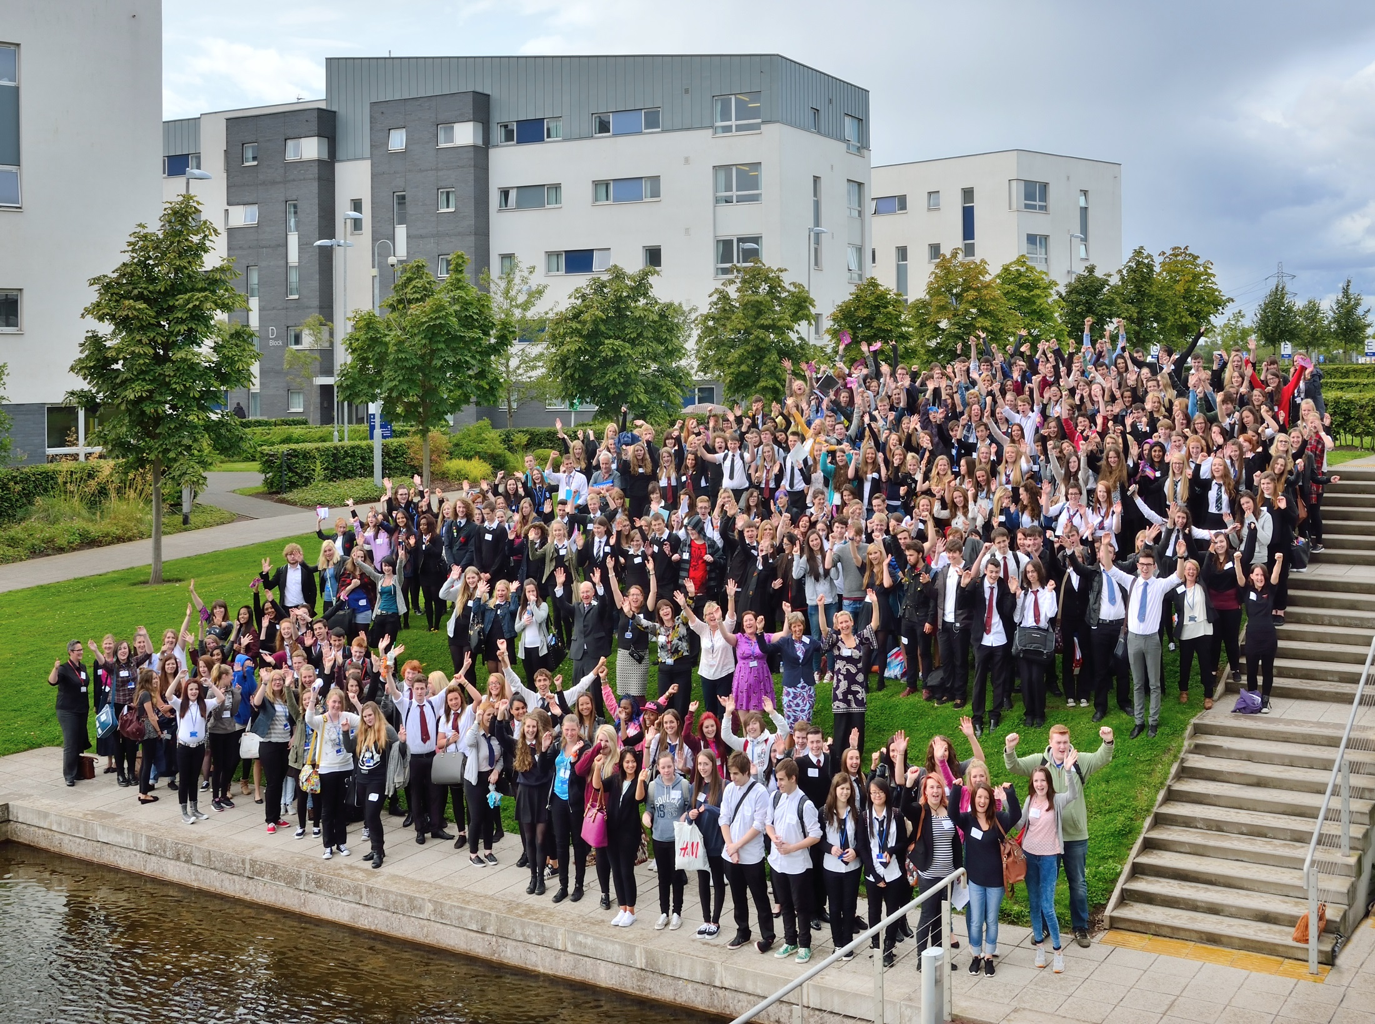

Slide 22
Notes:
Four way partnership between uni, college, schools and employers.
Young people in S5 and S6 are central to the Academy partnership.

