Slide 1
Effectively Applying Active Revision Techniques

Slide 2
Example – capitals of Europe

Slide 3
Highlighting and Colour Coding (V/K)
Use traffic lights
Red – don’t know at all
Amber – needs a bit of a reminder
Green – know already

Slide 6
Music (A)
https://www.youtube.com/watch?v=avUlYvIj3zs

Slide 7
FILL IN A BLANK MAP (V/K)

Slide 8
Mnemonics (VAK)
https://www.youtube.com/watch?v=qdCu2sKhYfk
https://www.mnemonic-device.com/geography/
https://www.youtube.com/watch?v=qdCu2sKhYfk

Slide 9
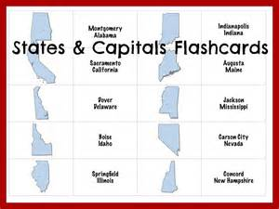
Flashcards (V/K)
http://memorize.com/europe-capitals/j98320

Slide 10
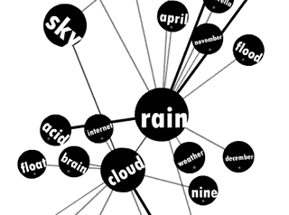
Word Association (V/A)
Eg
MADRID – think of a mad Spaniard
PRISTINA – think very clean Kosovan streets
BRATISLAVA – imagine Slovakia full of horrible teenagers
BRUSSELS - imagine Belgians eating their Christmas dinner
ANKARA – think of a boat using a turkey as an anchor
VILNIUS – Lithuania is full of villains
TALLINN – people are tall in Estonia
SOFIA – image a bull (Bulgaria) sitting on a sofa

