Slide 1
What are Interpersonal Skills?

Slide 2
Do Now Task: Write down all the interpersonal skills you can think of
Lesson Outcome: To help you develop an awareness of personal skills and their uses

Slide 3
The skills used by a person to properly interact with others. In the workplace, the term refers to an employee's ability to get along with others while getting the job done. Interpersonal skills include everything from communication, listening skills and having a positive attitude. Good interpersonal skills are a requirement for any employment opportunities.

Slide 4
Employee of the month…
What interpersonal skills would you look for in an employee of the month:
McDonalds / Burger King
JD Sports
Jobcentre
East Coast Trains
Hospital

Slide 5
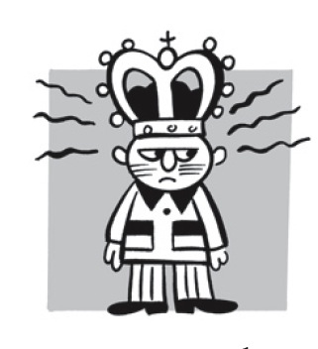
Employee of the Month Worksheet

Slide 6
Employee of the Month Answers
Time Keeping
Team worker.
Professionalism
Ability to use initiative/ Self starter
Completing tasks
or achieving goals or targets.
Representing the company well.
Going the extra mile/Going over and above job description
Most improvement in their job

Slide 7
Examine the picture below during a class discussion answer each of the questions
 | 1.What interpersonal Skills would you need to do this kind of work? 2.What will happen if you have poor interpersonal skills in this job? 3.How did education and training help you develop the skills required for this job?

Slide 8
Use of Interpersonal Skills Worksheet
 | 1. 2. 3.

Slide 9
Use of Interpersonal Skills Answers
 | - Good communication skills - eye contact - politeness - time management 2. - Customers may put put in complaints - company will have a bad name - you may lose you job 3. - writing skills - speaking and listening skills - number skills - following instructions

Slide 10
Examine the picture below during a class discussion answer each of the questions
 | 1. List some of the of the interpersonal skills that you would need to do this work. 2. Have you ever been treated by someone who did not have good interpersonal skills? If so, what was it like? 3. Do interpersonal skills in this work play a role in the actual success of the job?
Doctor

Slide 11
Use of Interpersonal Skills Worksheet
 | 1. 2. 3.
Doctor

Slide 12
Use of Interpersonal Skills Answers
 | - questioning skills - listening skills - empathy/ caring - confidentiality - non-judgemental - impatient staff- felt hurried - not listened to - felt ignored - my condition was trivialised (made to feel small ) - Yes because patients can be happy and satisfied
Doctor

Slide 13
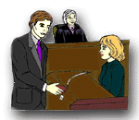
Examine the picture below during a class discussion answer each of the questions
 | 1.Are interpersonal skills important in the careers that these people are practicing? 2.What would happen if you lacked interpersonal skills in this job? 3.If you were going to employ the person on the left, what kind of interpersonal skills would you want him to have?
Solicitor

Slide 14
Use of Interpersonal Skills Worksheet
 | 1. 2. 3.
Solicitor

Slide 15
Use of Interpersonal Skills Answers
 | - Yes - Innocent people may be found guilty - Legal cases will be lost - Business will lose customers - As a solicitor you may lose your job 3. - Ability to negotiate - Ability to persuade - Professionalism/ Honesty - Ability to keep information confidential - Ability to make convincing speeches
Solicitor

Slide 16
Examine the picture below during a class discussion answer each of the questions
 | 1.What evidence is there that this person has no good interpersonal skills? 2. What kinds of interpersonal skills would be important in his work? 3. What should you do if you meet someone with these kind of interpersonal skills?
What work do I do?

Slide 17
Use of Interpersonal Skills Worksheet
 | 1. 2. 3.
What work do I do?
______________________

Slide 18
Use of Interpersonal Skills Answers
 | - Clenching teeth - On your face - Commanding/ Threatening - Intimidating 2. - People Skills - Negotiating - Ability to accept a NO answer - Ability to persuade - Ability to explain - Listening to customers needs - Be Assertive - Do not agree anything easily - Seek legal advice - Speak your mind
Sales representative

Slide 19
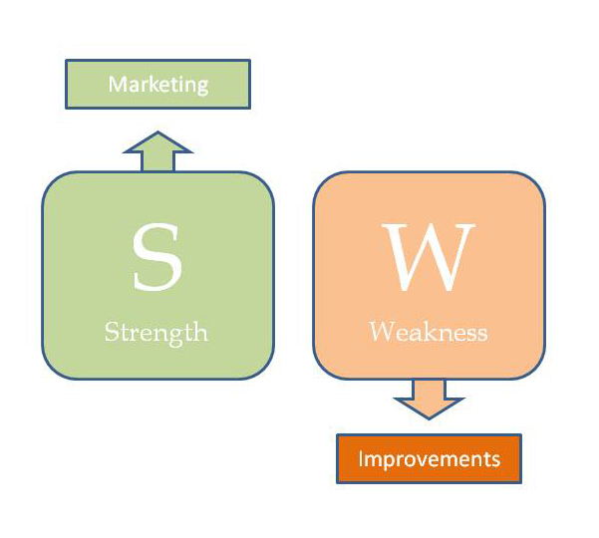
What are Strengths and Weaknesses?
Certain characteristics or personality qualities that help you to be successful in work or life in general
Certain characteristics or personality qualities that do not help one to be successful at work or in life general

Slide 20
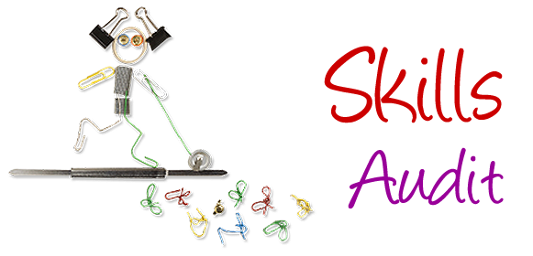
Personal Skills Audit
Complete the Skills Audit Task

Slide 21
SKILLS AUDIT
KEY | W-Weakness I really need to work on this. | N-Neutral Not entirely sure – I could still improve. | S-Strength – I’m really confident I can do this
Time and Self Management
I am able to organise my time so that I comfortably meet all my deadlines (Time management)
I know exactly where to go for help and support if I have difficulty completing a task (confidence to seek help and support)
I keep a diary or calendar so that I always know when I keep appointments and key dates
I arrive on time for classes, appointments and meetings (Punctuality)
I am aware of the things that cause me to waste time and am able to avoid them when I have work to complete (Time management)
I have future targets in mind regarding my education (and career) and use these to help me focus on current tasks (Plan ahead)

Slide 22
SKILLS AUDIT
KEY | W-Weakness. I really need to work on this. | N-Neutral (Not entirely sure) . I could still improve. | S-Strength . I’m really confident I can do this
Critical Thinking and Problem Solving
I am able to use different methods for investigating a problem such as considering different points of view or options. (Pull resources together)
I am able to consider a range of alternative solutions to a problem and predict the best one in a given situation. (Make decisions)
I am able to break down a complex problem (e.g. a work task, challenge in life) into simple parts (Problem solving skills)
I am able to work with others to solve problems (Team worker)
I know how to find out what is expected of me in a particular work task or challenging situation in life. (Use initiative)
Numeracy
I am confident that I have the mathematical and statistical skills needed to succeed at work and in life (Maths skills)
I am able to interpret information presented in graphs, charts, tables and diagrams. (Graphicacy)

Slide 23
SKILLS AUDIT
KEY | W-Weakness I really need to work on this. | N-Neutral Not entirely sure – I could still improve. | S-Strength – I’m really confident I can do this
Verbal Communication
In group discussions, I listen to others and I value and respond to their contribution even if I do not agree. (Listener, Tolerant)
I am confident that I can contribute ideas and opinions to a group discussion. (Make contributions in a group)
I think of relevant follow-up questions as people are speaking and ask them once they have finished . (Take and give turns in a conversation)
I am confident explaining new concepts and ideas to other people
I would be confident in giving a presentation or making a speech in front of other young people of my age

Slide 24
SKILLS AUDIT
KEY | W-Weakness. I really need to work on this. | N-Neutral (Not entirely sure) . I could still improve. | S-Strength . I’m really confident I can do this
Written communication
I am confident that I can structure an assignment in paragraphs in order to communicate my ideas effectively’. (Writing paragraphs)
I am confident that my written work has no grammatical, punctuation and spelling errors before I submit it (Grammar skills)
I am confident that I know the correct format and style for formal letters and documents, such as covering letters and CVs. (Writing skills)
I am able to produce useful and meaningful written notes from a speech or presentation that capture the key points . (Note making)
Information and Literacy Reading
I think about what I need to find out before I start reading (Reading skills)
I make useful, easy to follow notes while I am finding information for an assignment or project (Writing notes)
I can identify the points in a text which convey the author’s main arguments and supporting examples and references (Extract information)

Slide 25
Strengths and Weaknesses
Strengths
Weaknesses
1:
2:
3:
4:
1:
2:
3:
4:
Use the skills audit results to write a list of your strengths and weaknesses

Slide 26
Examples of Strengths and Weaknesses
Playful listener forgetful confident unpredictable sociable shy funny disorganised cheerful messy talker lively positive loud adventurous restless strong-willed reserved competitive too-frank diplomatic resourceful unaffectionate self-reliant headstrong daring argumentative outspoken nervy independent tactless decisive considerate domineering respectful manipulative sensitive insecure orderly methodical negative behaved loner loyal revengeful perfectionist aimless flexible timid peaceful slow submissive lazy patient hesitant friendly moody inoffensive rash consistent headstrong tolerant humorous ambitious insubordinate self-motivated inexperienced non co-operative team player co-operative take criticism punctual self starter creative

