Slide 1
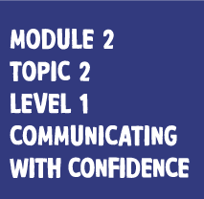

Slide 2
IN THIS ACTIVITY YOU’LL:
Understand that communication involves body language, tone and words
Know that how we speak and act can give us confidence
Identify how best to communicate in role-played scenarios.

Slide 3
WHEN DOES IT HELP TO BE CONFIDENT?
Job interviews
College interviews
Presenting to your class
Talking to customers
Talking with colleagues
With friends and family.

Slide 4
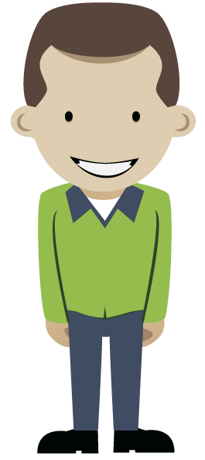
CONFIDENT BODY LANGUAGE
Lift your head and move your shoulders back
Stand straight and balanced
Smile!
Make eye contact
Face who you're talking to.

Slide 5
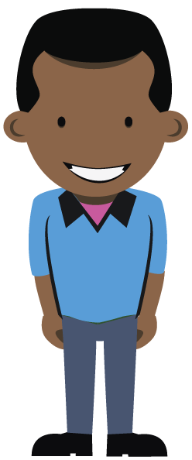
CONFIDENT TONE
Project your voice
Change the pitch and volume to show emotion
Use pace and pauses
Be clear and positive

Slide 6
CONFIDENT WORDS
Slow down and be clear
Use ‘active’ words: I need you to… This will work because… Think about it this way… Here’s why… | Avoid ‘filler’: It’s, like… Umm… You know what I mean? Yeah? What I’m saying is…

Slide 7
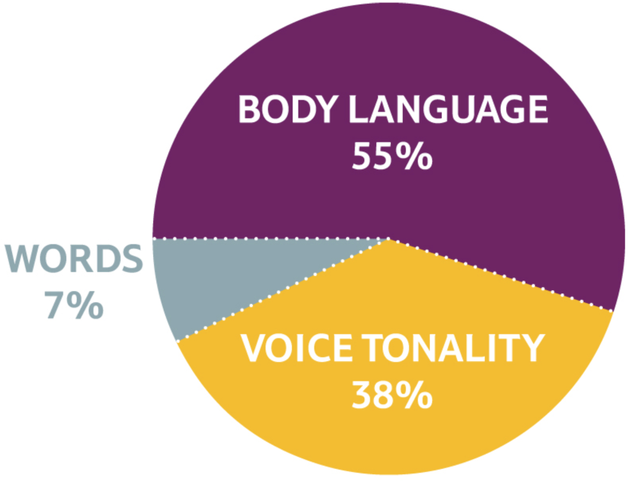
WHAT REALLY CONVEYS CONFIDENCE?

Slide 8
BUILD YOUR CONFIDENCE
Who around you shows confidence?
What can you ‘model’?
Remember to be authentic: true to who you are
Let your own personality shine through.

Slide 9
CONFIDENT BODY LANGUAGE
Start with your body language
Stand tall and smile
Move with purpose
Be ‘open’
Talk with a clear, positive tone
Use clear words that tell people what you want them to know or do.

Slide 10
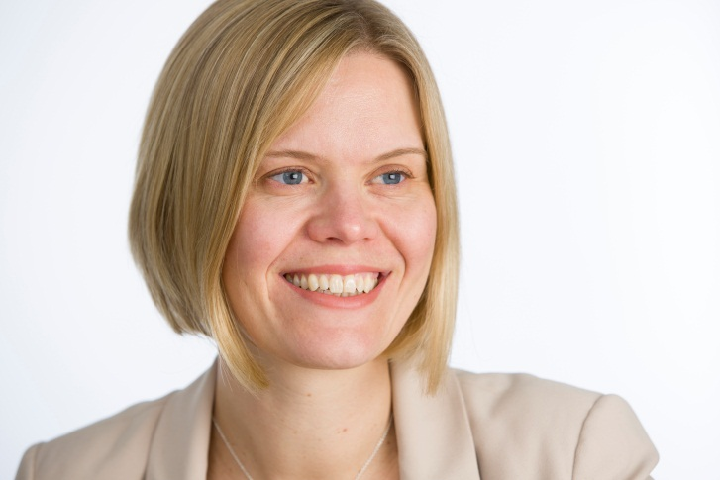
CASE STUDY
In the last few years I have been asked to present to our Store Managers on a number of occasions. Often the audience can be around 300 people – fairly daunting. During my preparation I always consider my “words, music and dance”. This being the importance of thinking through what I am going to say and importantly that I use words and phrases that are natural to me (the words), how I deliver it through my tone of voice and volume and use of humour (the music) and the way I stand, where I stand and how I move around the room to engage the audience more fully (the dance).
As the Customer Experience and Insight Director my role is to bring the voice of our customers into the decisions we then make to ensure we meet their needs in everything that we do and make every experience better.
Please include a photo of yourself
Tracey Clements, Customer Experience and Insight Director. Joined Tesco in 2002

Slide 11
WHAT ARE YOU GOING TO DO DIFFERENTLY?

