Slide 1
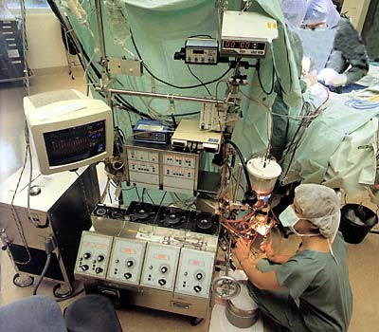
CAREERS in LIFE SCIENCES
Earlston High School

Slide 3
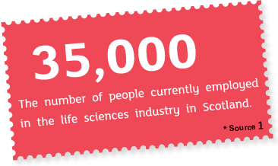
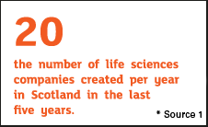
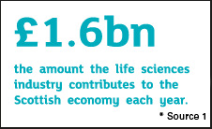
Statistics about Life Science

Slide 4
Some Careers in this Sector
Biochemist The sector wants to
Biologist encourage people aged
Chemist 16-24 to consider
Laboratory Technician careers in engineering,
Marine Biologist science and manufacturing
Pharmacist
Perfusionist
Pharmacy Assistant
Statistician
Procurement Officer

Slide 5
SKILLS NEEDED
Practical laboratory skills
Time management skills
Commercial awareness
Manual dexterity
IT skills
Concentration and patience
Accuracy
Remaining calm under pressure

Slide 6
The Future
Some of the jobs expected to increase in the next 2 years include:
Research assistants
Engineers
Technician level staff
Production and process technicians
Sales and marketing staff.

Slide 7
Different routes into Life Sciences
From School
From College
From University
Through Modern Apprenticeships
From Other Jobs
Through a personal route involving a mix of the above

Slide 8
Learning Opportunities
Borders College
YASS courses may include Exploring Science and Practical Science : Biology and Health
Work Experience?

Slide 9
University degrees- some examples
Glasgow University-BSc in Earth Science
University of Stirling-BSc in Aquatic Science
Abertay University-BSc in Biomedical Science
Edinburgh College also offers numerous courses related to life sciences
Borders College offers Higher Health Care

Slide 10
What can you do at school to help
Research opportunities/jobs/courses
Arrange relevant work experience and or volunteering
Take on Leadership and wider achievement opportunities in the school and local community which will help demonstrate and develop the key skills required to be successful.

Slide 11
Visit relevant establishments- e.g. businesses ,colleges , universities and talk to key people .
Carefully consider subject choices.
Ensure that you do all you can to maximise your grades and qualifications e.g. study techniques, attending help sessions, motivation for success.
Be AMBITIOUS yet REALISTIC

Slide 12
Modern Apprenticeship Route

