Slide 1
Careers in Creative Industries
Earlston High School

Slide 2
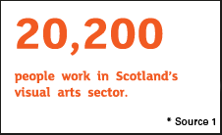
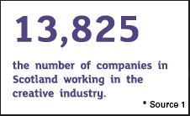
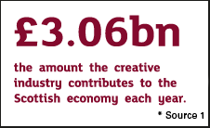
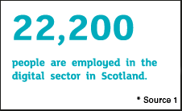
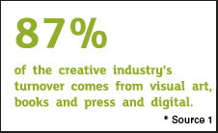
Statistics about the Creative industries
TV, radio, film, fashion and textiles, cultural heritage, design, literature, music and visual arts, are just some of the sectors in this industry. Many people who work in creative industries are self-employed, perfect if you have entrepreneurial flair.
“Scotland’s arts and creative industries sector is a real success story it employs up to 130,000 people in Scotland*. It has been chosen by the Scottish Government as an area that has the potential to substantially grow and provide more jobs in the future”
(* report commissioned by Creative Scotland and Scottish Enterprise)

Slide 4
Some Careers in this Sector
Actor
Architecture
Fine Artist
Choreographer
Costume Designer
Exhibition Designer
Fashion Designer
Graphic Designer
Illustrator
Interior Designer
Journalism
Lighting Technician
Make-up Artist
Pattern Cutter or Grader
Product Designer
Product Assistant
Sculptor
Set Designer
Sound Technician
Stage Manager
Textile Designer
Textile Operative
Writer or Author
Creative and cultural industries, which include craft, cultural heritage, design, literature, music, performing arts and visual arts have experienced rapid growth.
TV production in Scotland is projected to grow over the next three to five years. Also, behind the scenes roles in theatre and music performance are real growth sectors. Many roles, such as a live events producer, can work across a number of industries.

Slide 5
Skills Needed for these Jobs
Creative
People with good IT and digital skills are needed.
Management, leadership, marketing and communication skills are important in the fashion and textiles and creative and cultural industries.
Manage time, learn independently and take on responsibility.
Attention to detail
Ability to work as part of a wider team but carry out tasks independently
Flexibility in working hours and attitude
Resilience, take on board feedback and learn from mistakes
Growth Mindset
Numeracy, Financial, Literacy and Planning
Quick
Learner
Thinking
Problem Solving

Slide 6
Different routes into the Creative industries
There’s no set career route but most people in this industry are educated to degree level and it's common for new-starts to do unpaid work experience.
Many people in this industry start their own business by working freelance, so basic business skills such as planning and financial skills are essential.
From School
From College
From University
Through Modern Apprenticeships
From Other Jobs
Through personal route involving a mix of the above
For many roles within the fashion and textiles sector, you’ll need to have good knowledge of manufacturing processes and emerging technologies. Operative level workers should have a good eye for detail and if you want a design-related role you’ll need to be strong, creatively and technically.

Slide 7
What Can You Do At School To Help?
Research opportunities (jobs and courses) – develop Careers Management Skills using My World Of Work
Arrange relevant work experience (this could include volunteering)
Take on Leadership and Wider Achievement opportunities in the school that will help demonstrate and develop the key skills required to be successful in this field
Visit relevant establishments – eg businesses, colleges, universities and talk to key people there
Carefully consider subject choices (inc blended learning options – see next slide)
Ensure that you do all you can to maximise your grades and qualifications (eg study techniques, attending help sessions, motivation for success…)
Be AMBITIOUS yet REALISTIC

Slide 8
Blended Learning opportunities
Software Design at Borders College – Nat4/5
Creative Academy at QMU Academies ; Media and Communications HNC, Acting and Performance HNC
YASS courses (S6 only) include: English for academic purposes online, The arts past and present , Design thinking: creativity for the 21st century
Work Experience

Slide 9
College Opportunities
Borders College Courses
Art and Design Level 2 and 3
Beauty Therapy Level 1-3
Fashion and Make-up HNC
Digital Media NC
Interactive Media HNC
Graphic Design HND
Edinburgh College Courses – some of the many are shown on the link

Slide 10
University Degrees – some examples
Napier University- Acting and English BA, Acting for Stage and Screen BA , Design and Digital Arts - BDes, English and Film BA
Stirling University – Digital Media BA , European Film and Media BA, Film and Media BA, Journalism Studies BA
Edinburgh University – Scottish Literature MA, Animation BA, Film and Television BA, Interior Design BA, Textiles BA, Performance Costume BA, Fashion BA, Music Technology BMus
Glasgow University – Theatre Studies MA, Computing/Theatre Studies MA,
Royal Conservatoire of Scotland –Production Arts and Design BA,
University of the West of Scotland – Contemporary Screen Acting BA, Film Making and Screen Writing BA, Musical Theatre BA, Technical Theate BA
Go to www.ucas.com to look at all options

Slide 11
Modern Apprenticeship Route
Possible Modern Apprenticeships available in:
Creative and Digital Media
Creative
Fashion and Textile Heritage
MA in Textiles

Slide 12
Careers in Creative Industry: Case Studies
Ewan’s Career In Broadcast Journalism
Fraser Thomson, DJ
Shaun K – Stage Technician

Slide 13
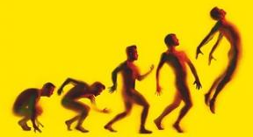
The Learner Journey - Creative
This presentation and all other associated info and links – eg Careers, Higher and Further Education – can be found on the school Guidance website (get the link from the school website)

