Slide 1
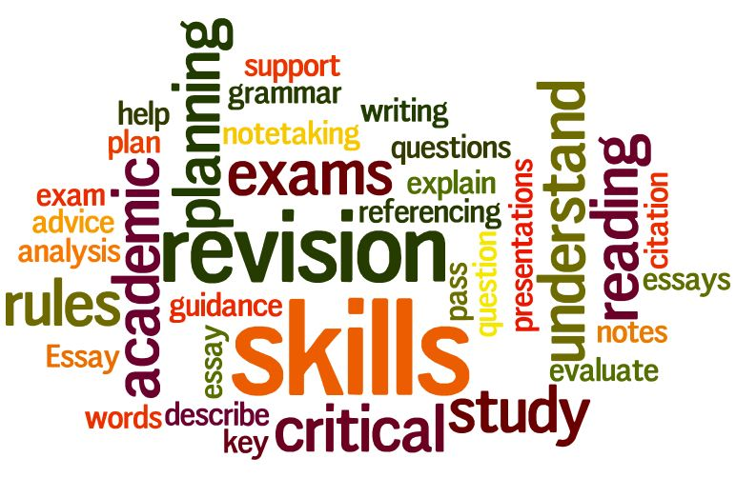
Study Skills
S4 Learning for Excellence

Slide 2
Learning intentions
By the end of this lesson you should be able to:
Have an understanding of how you study best
Get organised for revision

Slide 3
Learning Styles
You will probably have a preferred learning style:
Visual
Auditory
Kinaesthetic
Your revision methods will be more effective if you use ones which matches your learning style or a combination of styles.
But no-one has only one learning style
Task 1: Complete the learning styles questionnaire

Slide 4
Task 2
On the back of your learning styles quiz, write down 3 ways you could revise/study based on your learning style.
Now look at the following slides and note down any more you think will help you revise. It can be from a mixture of learning styles

Slide 5
Which learning style is this?
Kinaesthetic
Move around while studying – even exercise
Use “stress toys” to play with while studying
Write or type and re-write notes
Copy onto revision cards – carry these around with you
Practice on models / mock ups
Tap to reinforce rhythms of notes
Draw Mindmaps, diagrams, posters – in relevant detail and coloured/shaded

Slide 6
Which learning style is this?
VISUAL
Draw and re-draw Mindmaps / Spider diagrams, etc
Underline important information
Write different info in different coloured ink
Use highlighting pens in different colours
Use different coloured paper for different topics
Make posters – stick them on walls
Re-write notes
Copy them onto revision cards
Doodle
Visualise key facts

Slide 7
So this must be…
Auditory
Read notes out loud
Record notes onto MP3 and listen to them
Verbalise questions from notes
Answer questions out loud
Discuss topics with study “buddy” or in group
Argue or debate a subject with yourself
Teach other people

Slide 8
When revision doesn’t work
Interference – when one bit of information gets confused with another. Avoid studying similar subjects together to reduce this.
Lack of meaningful revision - a ‘sense’ of work without real work. This often happens when you are, for example, checking Facebook/email whilst you revise: you think you’re revising, but really you’re thinking about Facebook/email: your brain is in social mode, not learning mode.
Stress/Panic – this happens often when you leave studying too late, and therefore overload your working memory.

Slide 9
Distractions
Task 3
With a partner write down as many things that can distract you from revision
Discuss as a class – Take suggestions on the board
Now write down your own personal top 5 distractions down the left hand side of your paper
Next to each distraction write down a way this can be avoided
As a class, go back to the suggestions on the board and come up with as many ways to avoid these distractions as possible

Slide 10
Planning for revision
Where do you revise? - Discuss
NOT in front of the television/ DVD, etc
Not in front of the computer with Facebook, email, etc on the screen or in the background
Turn OFF your phone (you can check it as a reward later)
Away from as many distractions as you can - including family.
Ideally at a table or desk

Slide 11
Planning for revision
Where do you revise?
Collect everything you’ll need together – notes, books, sweets, drinks, paper, pens, clock or watch, etc
Music?
Library?
With friends?
Take notes or revision cards with you wherever you go

Slide 12
Planning for revision
With Friends? – discuss
For some people revising with friends is a good idea
…as long as the friend is there to revise too
You can ask each other questions and answer them
You can explain things to each other
You can motivate each other
Even with boring topics
You can keep each other on timetable

Slide 13
Planning for revision
Timetable
Of course, you should have a revision timetable to work to
Try to follow this as closely as you can
Give yourself regular short breaks
Reward yourself with longer breaks and activities
Adjust your timetable WHEN NECESSARY

Slide 14
Top Tips..
On a post-it note write your own personal top tip for revision. It should be something you have tried that works for you.
Now stick this to the board. – Your teacher will read some of these out for discussion. Maybe your teacher has a top tip too?

Slide 15
How your brains works…
When we learn something for the first time, we use our working memory.
The working memory is quite small (typically between 5-9 items).
Therefore, to learn something properly, we have to shift it from our working memory to our long-term memory.

Slide 16
How your brain works…
EVERYONE’S brain needs the same 3 things for this to happen:
Repetition – so start early or you won’t have time for this.
Multi-modal activities – i.e. something which is visual (seen), auditory (heard) and kinaesthetic (physically done). It also helps if it has an emotional element, such as humour.
Effort – it won’t happen unless you ACTIVELY revise.

Slide 17
Revision Pledge
Make a pledge (promise) to yourself. What change will you make to improve your revision?
It could be a tip you have learned today or a way to avoid distraction
Write it on a strip of paper “I promise to improve my revision by__________” Sign and date this and give it to your teacher.
Note your pledge in your homework diary
Your teacher may pull some of these pledges out in the next lesson to check you have implemented this change

Slide 18
Homework - research
If you have access to the internet or YouTube, spend 30 minutes looking at information or videos on revision techniques, there are thousands!
If you don’t have access to the internet ask someone at home, like an older sibling perhaps who may have a tip or technique which worked for them.

